Slide 1
6130 Presentation
Devanshi Rajpara, Jeevesh Awal, Lakshay Bareja, Meghrajsinh Chauhan, Nithish Reddy Yalaka, Rohan Pagey, Venkata Narsu Pavani Shrinija Dosapati, Siva Teja Narayanabhattula

Slide 2
Presentation Plan
Topic | Time | Presenter | Session
Project Overview | 4:00 minutes | Jeevesh | PPT for Presentation Flow
Vulnerable Web Application | 1:00 minute | Jeevesh | Live
Attacks on Web Application | 3:00 minutes | Devanshi | Recorded
RunC Vulnerability (CVE20195076) | 3:30 minutes | Lakshay | Recorded
Docker Socket Vulnerability | 2:30 minutes | Lakshay | Recorded
Docker Registry | 2:30 minute | Rohan | Recorded
Docker Group | 1:30 minutes | Rohan | Recorded
CHMS (Security Framework) | 5:00 minutes | Jeevesh | Live
Android App (Security Monitoring) | 1:00 minute | Siva | Recorded

Slide 3
Overview of Project
Docker Application Attacks
SQL Injection
OS Command Injection
Malicious File Upload
BruteForce
XSS
Session Hijacking
Custom Docker Image for implementing Application Attacks
Attacks on Container
Docker Socket
RunC (CVE20195736)
Docker Private Registry Expose
Docker Group Configuration
Cryptojacking
Custom Docker Image - Stressjack for crypto analysis
Security Application
Preventing Application Attacks
Docker Container Management
Android Application for CHMS
Preventing Attacks using CHMS (Container Health Monitoring System):
Breaking Reverse Shell
Reverting Docker Socket
Detecting and Mitigating RunC Vulnerability
Detecting Insecure Registry
Detecting Container Privilege
Checking Container Integrity
Container Command Logging

Slide 4
Workload Distribution
Devanshi Rajpara | 40164374 | Web Application Frontend and Security Application (CHMS)
Jeevesh Awal | 40169864 | Web Application Backend and Security Application (CHMS)
Lakshay Bareja | 40156832 | Docker Attack, Security Application Backend
Meghrajsinh Chauhan | 40156699 | Web Application Attack and OS Environment Setup
Nithish Reddy Yalaka | 40164619 | Docker Setup, Implementation and Project Report
Rohan Pagey | 40168378 | Docker Attack, Security Application Backend
Venkata Narsu Pavani Shrinija Dosapati | 40162308 | Docker Environment Setup
Siva Teja Narayanabhattula | 40166568 | Mobile Application for Security Application (CHMS)

Slide 5
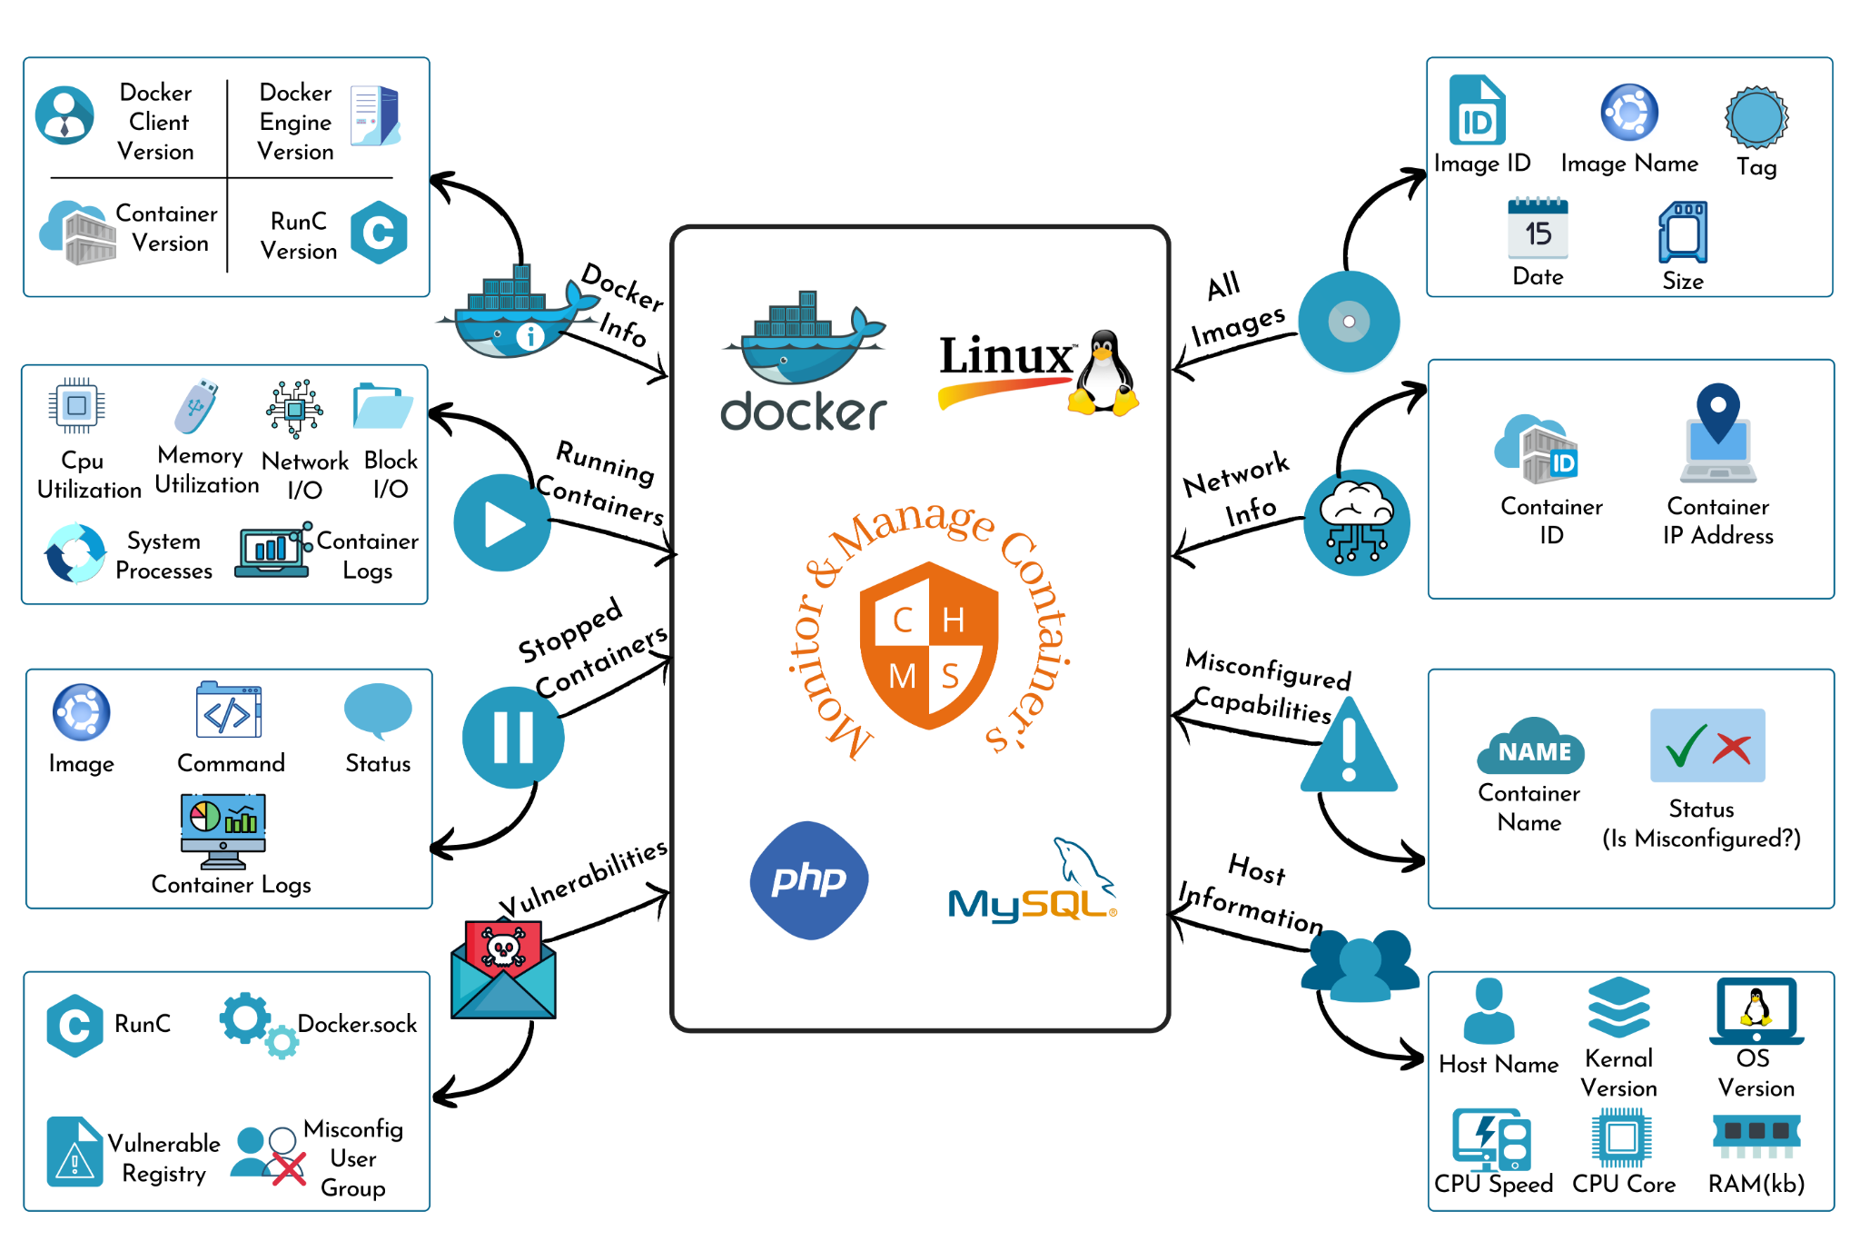
Container Health Monitoring System

Slide 6
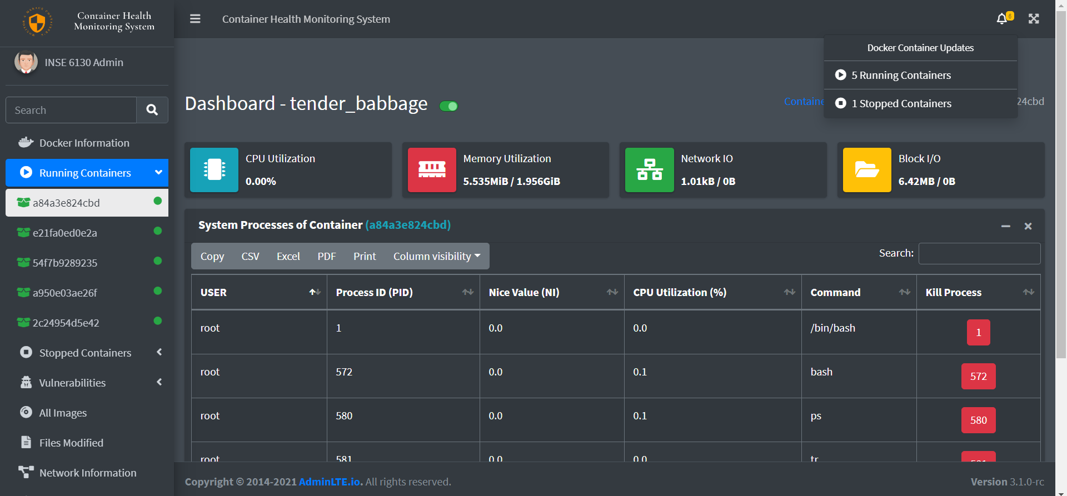
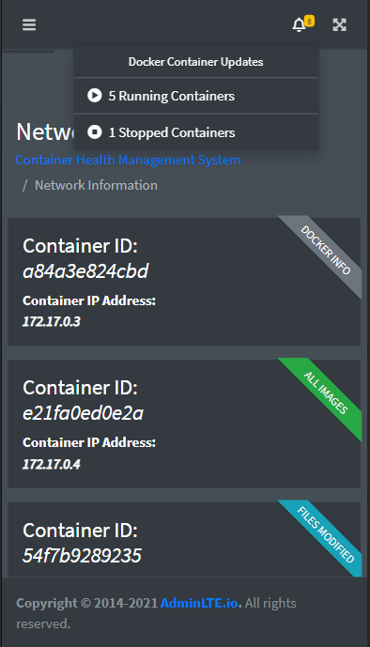
Place your screenshot here
Container Health Monitoring System

Slide 7

Challenges
Questions?
our University
Our Group

